Slide 1
Portfolio Recommendation
Capstone project for the Analyze Financial Data with Python Skill Path.

Slide 2
Recommended Stocks
Ticker | Name | Sector | Industry | Latest News | Latest Annual Revenue ($bn) | Market Capitalization ($bn) | Close Price ($/share) | P/E (x)
GOOG | Alphabet Inc | Communication Services | Internet Content & Information | News | 257.64 | 1,851.42 | 2,729.57 | 25.01
QCOM | QUALCOMM, Inc. | Technology | Semiconductor | News | 33.57 | 177.63 | 155.59 | 18.06
LMT | Lockheed Martin Corporation | Industrials | Aerospace & Defense | News | 67.04 | 117.43 | 440.00 | 19.35
FB | Meta Platforms Inc | Communication Services | Communication Services | News | 117.93 | 589.71 | 211.49 | 15.73
AMD | Advanced Micro Devices, Inc. | Technology | Semiconductor | News | 16.43 | 186.79 | 115.92 | 44.61
V | Visa Inc | Financial Services | Credit Services | News | 24.11 | 458.09 | 217.04 | 43.41
Data as on March 23, 2022
Source : Google Finance, Yahoo Finance

Slide 3
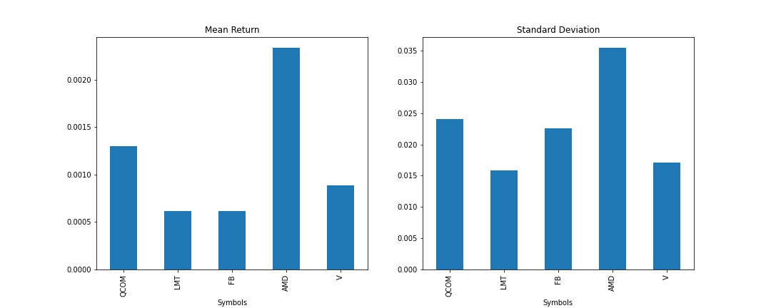
5 Years’ Historical Stock Performance
Source: Adjusted prices from Yahoo Finance, Own calculation
The stocks with the highest return are also the one with the highest volatilities. AMD offered the highest return followed by QCOM. The duo leads in volatility at same order. FB is a notable difference with a volatility disproportionately higher compared to others.

Slide 4
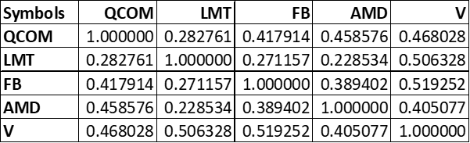
Correlation Among The Stocks
Despite most of the stocks being from technology sector, they have low correlations (<0.50) among themselves. LMT being a defence company has the least correlation with all the other stocks.

Slide 5
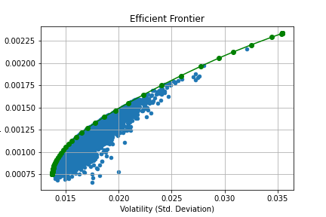
Random Portfolios and Efficient Frontier
The plot depicts risk-return trade-off for 5,000 randomly generated portfolios with our selected stocks. The green curve represents the efficient frontier.

Slide 6
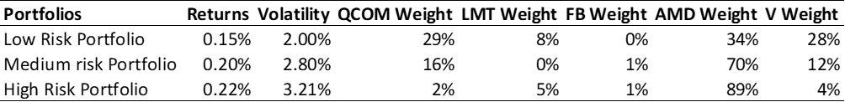
Portfolio Recommendations
Three different portfolio recommendations are made for different risk tolerance level of the investors. The recommendation module finds out the highest return yielding portfolios of all the random portfolios with a volatility level lower than the investors’ risk tolerance.

Slide 7
End

